Slide 1
Teck Ghee Arc A39

Slide 2
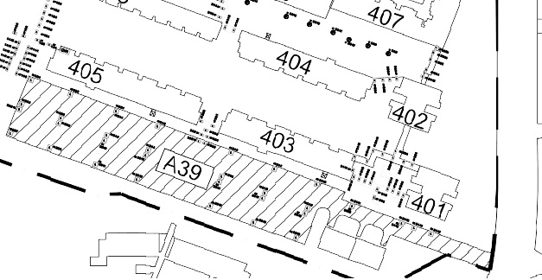
Block A39 CAR PARK SPACE PLAN

Slide 3
405
403
Ang Mo Kio Ave 10
401
A39

